Slide 1
Rewards and Recognition | Arvind Applause Program

Slide 2
The Agenda
Arvind Applause Program - An overview
Corporate Rewards Summary
Launched Award categories :
Instant Recognition Awards
Value Awards
Long Service Awards
Spotlight Awards
Retail Awards
Reward payout

Slide 3
Arvind Applause Program
What is Recognition
Sincere
Specific
Consistent
Arvind Applause Program
Reinforce organization’s culture and values
FORMAL
Long Service Awards
Attract, retain and motivate employees
INFORMAL
Retail Awards
Value Awards
Reinforce performance and behaviors outputs
REGULAR & IMMEDIATE
Instant Recognition
Spotlight Awards
External Competitiveness

Slide 4
Value Award | Sr. Manager & below
The Values Awards have been designed to reward and recognize individuals who live the organization’s mission and are role models exemplifying the Core Values. This award is incorporated to honour the achievements of the employees who really do live the values and go above and beyond their business role.
Value Award - Service
Value Award - Innovation
Value Award - Living the Brand
Value Award - Collaborate
Value Award - Care
Eligibility | Award Criteria
All employees Sr. Manager level & below The employee should have spent minimum 6 months in the organization | Achievement Narrative [100%]
Achievement Narrative:
Provide the description as to how the nominee has gone above and beyond the call of his duty and has demonstrated the respective value (word limit - 350 words).

Slide 5
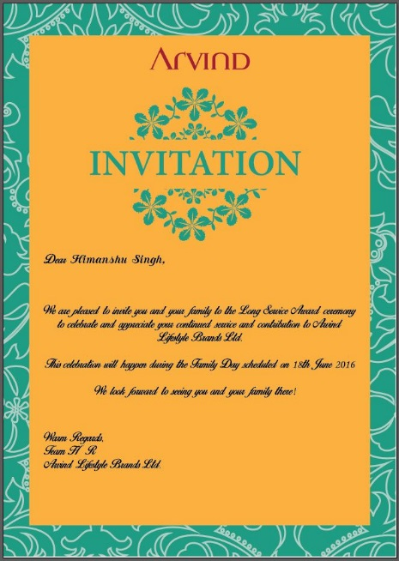
Long Service Award | All Employees
The Long Service Awards are to recognise and demonstrate the appreciation of loyalty and commitment of long serving employees who have completed 7; 10; 15 years of continuous service.
The purpose of this reward is to acknowledge the contribution of the employees who have dedicated themselves to the service of the organization.
Eligibility | Award Criteria
All employees on the direct rolls of ALBL. | Gold - Completion of 7 years Platinum - Completion of 10 years Diamond - Completion of 15 years

Slide 6
Instant Recognition Award | All Employees
This award has been constituted to instantly recognize and appreciate any employee for any form of support/help extended within or outside purview of work. This platform could be used to appreciate some gesture or a behaviour of an employee.
This kind of recognition truly makes the link between the recognition received and the behaviour exhibited. This gives everyone the tools and the push they need to highlight behaviours that lead to achievement.
Types of recognition categorised below:
You Rock!
Well Done!
Thankyou!
The recognition cards can be given via Peer to Peer, Top – Down or Bottom – Up.
Instant Recognition card boxes will be placed on every floor for ready use.

Slide 7
Spotlight Award | Manager and Below
Spot Light Awards are designed to recognize special contributions, as they occur, for a specific project or task. These Awards are generally for a special contribution accomplished over a relatively short time period. A Spot Light Award lets employees know that someone has observed and would like to recognise their noteworthy contribution. The award will be through the recently launched Vantage Points which can be redeemed at various offline and online stores.
Eligibility | Process
Employee/s should be a corporate onroll staff Performance rating – Meets expectation or above Contribution / efforts should have been achieved in the last 1-2 months Cross functional nominations are invited as well | Nomination should be from the reporting manager / Business Head / Support Head Each business will be given a budget for the year (per below) from which they can utilise to reward employees in individual or team category.

Slide 8
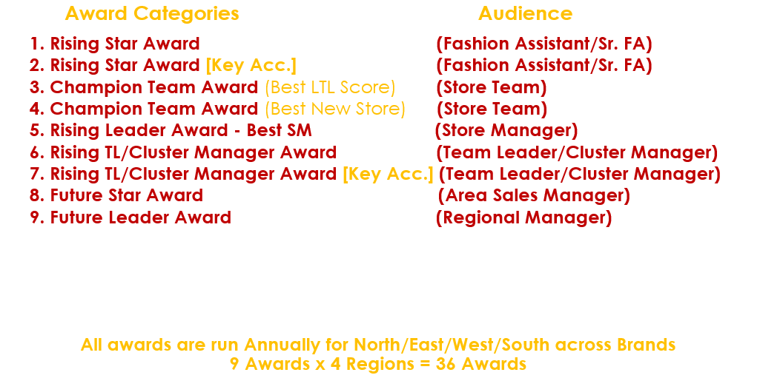
Retail Awards| All Retail & Regional
Retail Awards are The Retail Awards is aimed to honor exceptional work done by the Retail staff, demonstrating a behaviour and commitment to deliver excellence in the retail environment. The overall performance is characterized by epitome of excellent workmanship, seamless passion, unmatched energy and professional integrity.
These are annual awards that are run across all regions & brands.
All Individual awards are given in the form of Vantage Circle points and
Team Lunch/Dinner for Team awards

Slide 9
Reward Payouts
To bring the Arvind Applause to life, we had integrated it into a Digital Platform in Partnership with Vantage Circle.
The platform recognizes employees through ‘Vantage Reward Points’ under various reward categories. Employees can go ahead and redeem these earned points through the purchase of various lifestyle categories like electronics, home, apparel, travel, health & food partners.
In addition to this, the platform also offers an opportunity for employees to benefit from exclusive online deals, quizzes, surveys etc.
Remember, 1 Vantage Point = 1 Rupee
Mentioned below is a simple & easy 5-step registration & login process:
(Mobile App version is available on both Android and IOS versions)
Step 1 | Register using your Corporate email id on www.vantagecircle.com
Step 2 | Click on the Login button and enter your official email id.
Step 3 | You will immediately receive a verification email from Vantage Circle. Click on theArvind Vantage Circle link provided in the email.
Step 4 | Complete the registration process by filling the required personal information
Step 5 | You will now be able to view the site, earn points and avail offers!
Points once given, expires within 1 year

